Slide 1
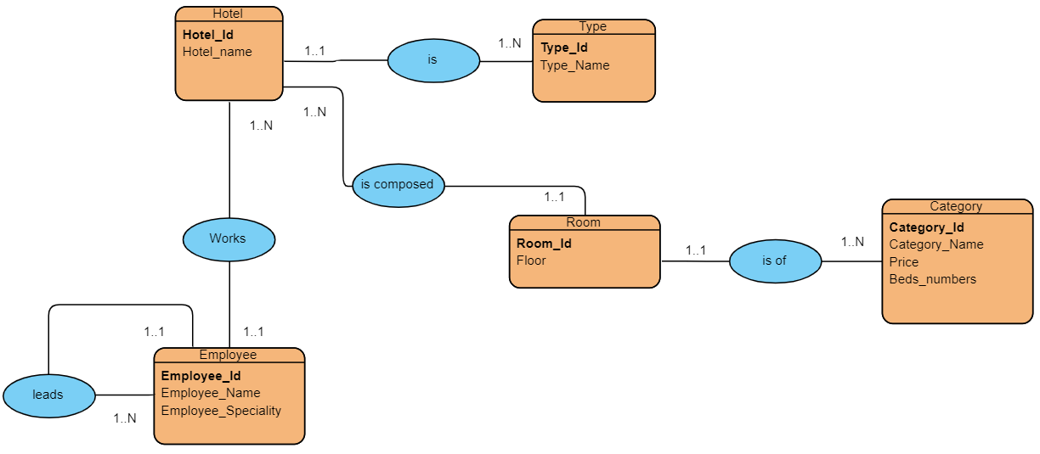
Entity–relationship model :
Relational model :
Hotel( Hotel_id , Hotel_name , #Type_id)
Type( Type_id , Type_Name)
Room(Room_id, Floor, #Hotel_id , #Category_id)
Category(Category_id , Category_Name, Price , Beds_numbers )
Employee(Employee_id, Employee_Name , Employee_Speciality, #director_id , #Hotel_id)

